Slide 1

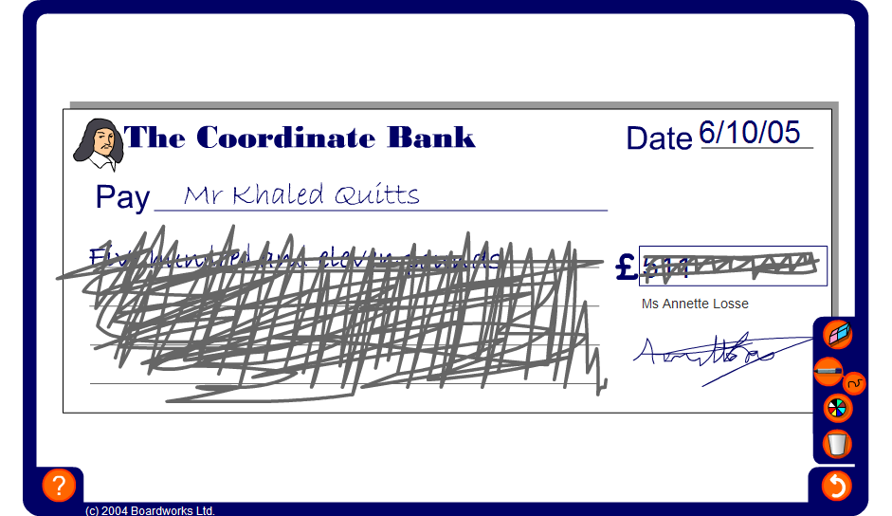


Blank cheques
Notes:
The aim of the activity is to ensure that pupils are able to read large numbers in the context of money.
Ask pupils why they think it is necessary to write amounts of money in words on cheques.
Start by revealing the amount of money on the cheque in figures and asking pupils how it would be written in words. Repeat the activity with the amount of money shown in words and ask pupils how it would be written in figures.
Point out to pupils that in the context of money 302.76 is read as ‘three hundred and two pounds, seventy-six’. If this number were not in the context of money it would be read as ‘three hundred and two point seven six’. When we say ‘seventy-six’ in the context of money we are referring to seventy-six pence. When we say ‘point seven six’ in the context of decimal numbers we are referring to 7 tenths and 6 hundredths.
Also stress that the decimal 4.50 is usually written as 4.5. However, we cannot write £4.5 in the context of money. This must be written as £4.50.
When writing amounts of money we cannot combine units, for example £6.73p is not allowed. This must be written either as £6.73 or as 673p.

